Slide 1

Case Study-Global Commodity Prices
-D.Siddhartha Alexander

Slide 2
Table of contents
1.Problem Statement
2.Project objective
3.Data description
4.Visualization techniques and Tools

Slide 3
Problem statement
The problem is to analyze commodity prices for various commodities using the commodity prices dataset. The goal is to leverage Python, data science techniques, statistical analysis and data modeling. Perform all necessary steps to get the key insights from the data

Slide 4
Project Objective: This project leverages Python libraries like NumPy, Pandas, Seaborn, and Matplotlib to analyze and visualize global commodity price trends (1960–2022), focusing on key commodities such as oil, coffee, tea, and sugar.
Goals:
Identify long-term trends and seasonal variations in prices.
Detect outliers and price fluctuations indicating market instability.
Analyze correlations between regional and global commodity prices.
Use visualizations to answer analytical questions about distribution patterns, percentiles, and price comparisons.
Impact: The insights will enhance understanding of market dynamics, support economic forecasting, and enable informed decision-making. Clear, impactful visual storytelling will be emphasized to simplify complex data.

Slide 5
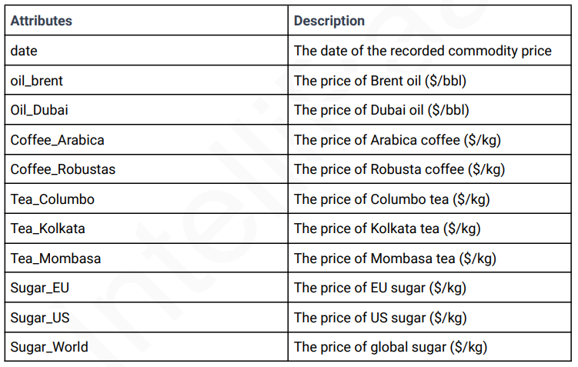
Description:

Slide 6
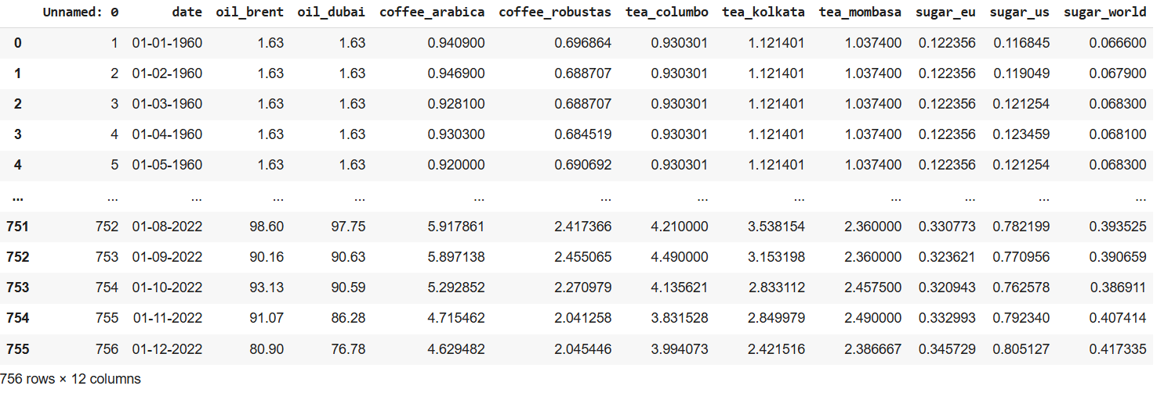
Supporting information
1

Slide 7
Visualization Tools:
This section highlights the tools and libraries utilized for data analysis and visualization. The focus is on Python-based tools alongside a variety of visualization techniques to present insights effectively. The tools include NumPy, Pandas, Seaborn, Matplotlib, and SciPy, as well as additional options like Plotly for interactive visualizations. These tools collectively enable robust data analysis, statistical computation, and visually compelling storytelling.
1. NumPy
NumPy (Numerical Python) is a core library for numerical computations in Python. It provides:
Efficient array operations, mathematical functions, and random number generation.
Tools for handling missing data, performing simulations, and calculating statistical metrics like mean, standard deviation, and variance.
Foundation for more advanced data manipulation libraries like Pandas.
2. Pandas
Pandas is designed for handling structured data, such as tabular datasets in Data Frames and Series formats. Key functionalities include:
Loading, cleaning, and transforming data.
Supporting time-series analysis, data filtering, and summarization.
Seamlessly integrating with visualization libraries for smooth data-to-visualization workflows.

Slide 8
3. Seaborn
Seaborn is built on top of Matplotlib and specializes in statistical data visualization. Its features include:
Simplified creation of complex visualizations with aesthetic customization.
Built-in support for displaying relationships, distributions, and categories in data.
Ability to create heatmaps, pair plots, and regression plots with minimal code.
4. Matplotlib
Matplotlib is a foundational Python library for creating static, animated, and interactive visualizations. Its capabilities include:
Generating a wide variety of plots, such as line charts, scatter plots, bar graphs, and histograms.
Full control over plot customization, including layout, axes, labels, and styles.
Useful for displaying temporal trends, categorical comparisons, and distribution analysis.
5. SciPy
SciPy complements NumPy by offering advanced mathematical and statistical functions, such as:
Signal processing, interpolation, and optimization.
Hypothesis testing and other statistical tools for in-depth analysis.
Seamless integration with visualization libraries to enhance data analysis workflows.

Slide 9
Visualization Techniques
The following techniques are employed to present data insights:
Line Charts: Depict trends over time, such as price changes across decades.
Scatter Plots: Show correlations and relationships between variables.
Histograms: Analyze the distribution of data and identify outliers.
Heatmaps: Highlight patterns in data through color intensity.
Box Plots: Provide summaries of data distribution, including median, quartiles, and outliers.
By combining these tools and techniques, this project ensures a clear and insightful visual narrative, supporting analytical goals and aiding in decision-making processes.

Slide 10
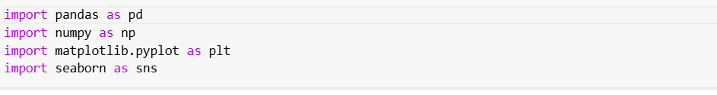
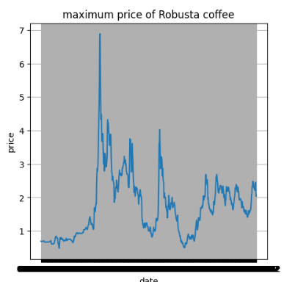
Importing Libraries
What is the maximum price of Robusta coffee ?
df['coffee_robustas'].max()
plt.figure(figsize=(5,5))
plt.plot(df['date'],df['coffee_robustas'])
plt.xlabel('date')
plt.ylabel('price')
plt.title('maximum price of Robusta coffee')
plt.grid(True)
plt.show()

Slide 11
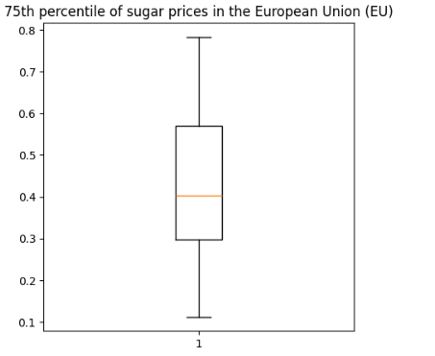
What is the 75th percentile of sugar prices in the European Union (EU)?
plt.figure(figsize=(5,5))
plt.boxplot(df['sugar_eu'])
plt.title('75th percentile of sugar prices in the European Union (EU)')
plt.show()

Slide 12

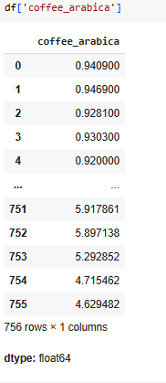
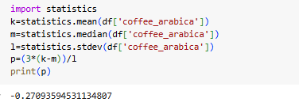
What is the skewness of the price distribution for Arabica coffee?
Formula :

Slide 13
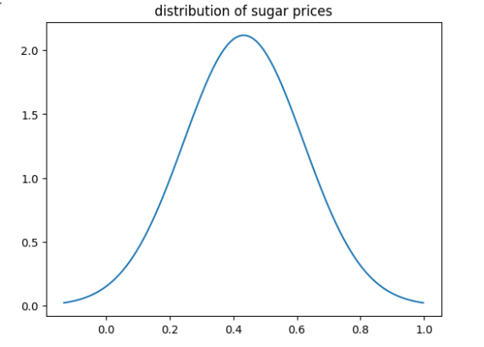
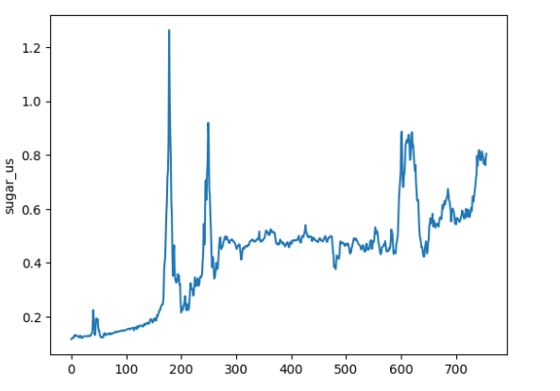
Is the distribution of sugar prices in the US signicantly different from a normal distribution?
from scipy.stats import norm
import numpy as np
import matplotlib.pyplot as plt
mean=np.mean(df['sugar_us'])
sd=np.std(df['sugar_us'])
x_axis=np.linspace(mean - 3 * sd, mean + 3 * sd, 100)
plt.plot(x_axis, norm.pdf(x_axis, mean, sd))
plt.title('distribution of sugar prices')
plt.show()
sns.lineplot(df['sugar_us'])
plt.show()

Slide 14
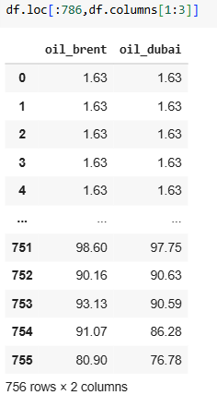
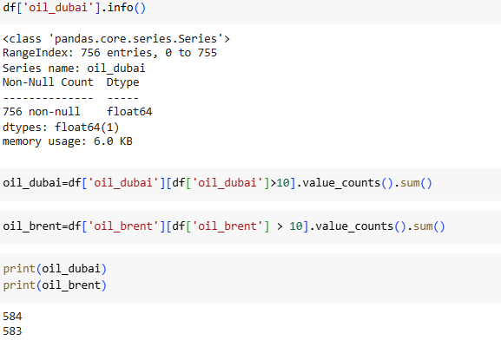
How many times does the price of Dubai oil exceed the price of Brent oil by a certain threshold $10 ?

Slide 15
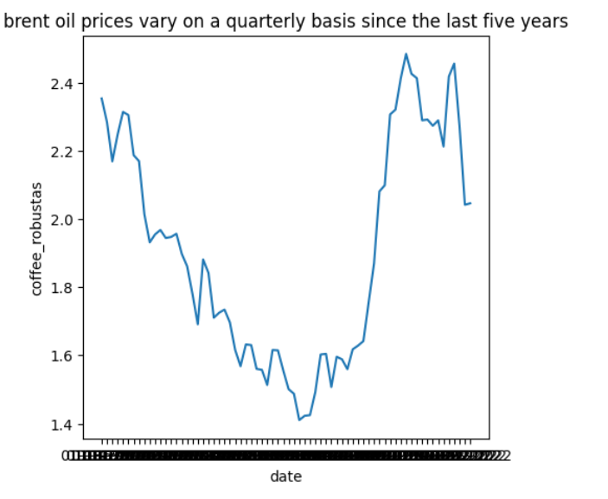
How has brent oil prices vary on a quarterly basis since the last five years?
m=df.iloc[686:]
plt.figure(figsize=(5,5))
sns.lineplot(data=m,x='date',y='coffee_robustas')
plt.title('brent oil prices vary on a quarterly basis since the last five years')
plt.show()

Slide 16
THANK YOU

